Slide 1
IS Principles
Faisal Iradat

Slide 2
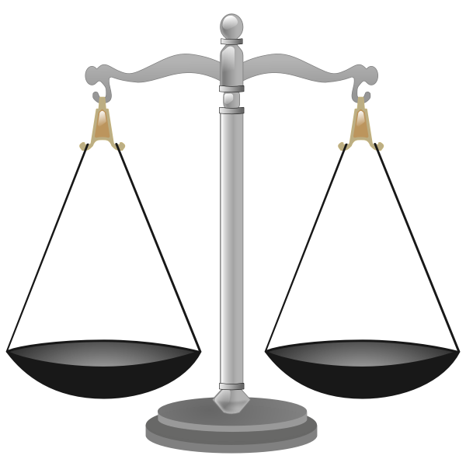
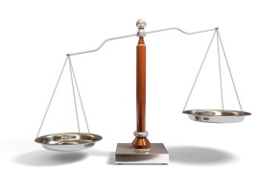
The CIA Triad
Confidentiality
Data is secured
Prevent unauthorized access to data
HR & Marketing have their own file servers
Authentication and Access Control
Maintain a Level of Confidentiality
Integrity
Ensuring our data hasn’t been tempered with or modified
Hashing
Hash calculator
Hacker puts a malware
https://www.ibm.com/support/pages/how-verify-integrity-download-resource
Availability
Cant just lock everything down
All 3 equally important & intertwined
Confidentiality
Availability
Integrity

Slide 3
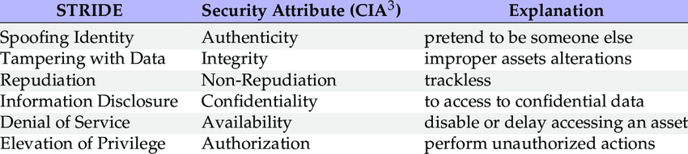
The CIA Triad
STRIDE
Model for identifying computer security threats developed by Praerit Garg and Loren Kohnfelder at Microsoft.
DREAD
MITRE ATT&CK

Slide 4
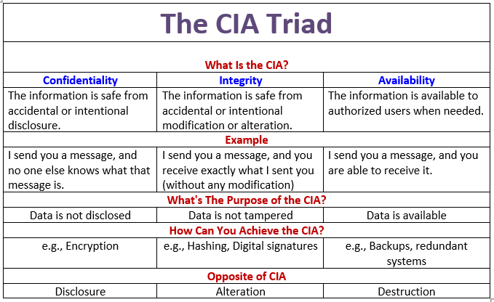
The CIA Triad

Slide 5
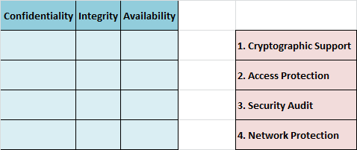
The CIA Triad

Slide 6
Authentication, Authorization & Accounting (AAA)
AAA is an information security framework for controlling access to data and system resources, enforcing policies, and auditing actions
Authentication
Verifies user’s identification via the process of logging into a system
Authorization (Access Control)
Determines what a user has the authority to do and have access to
Accounting
Tracks and records user access and actions with system logs

Slide 7
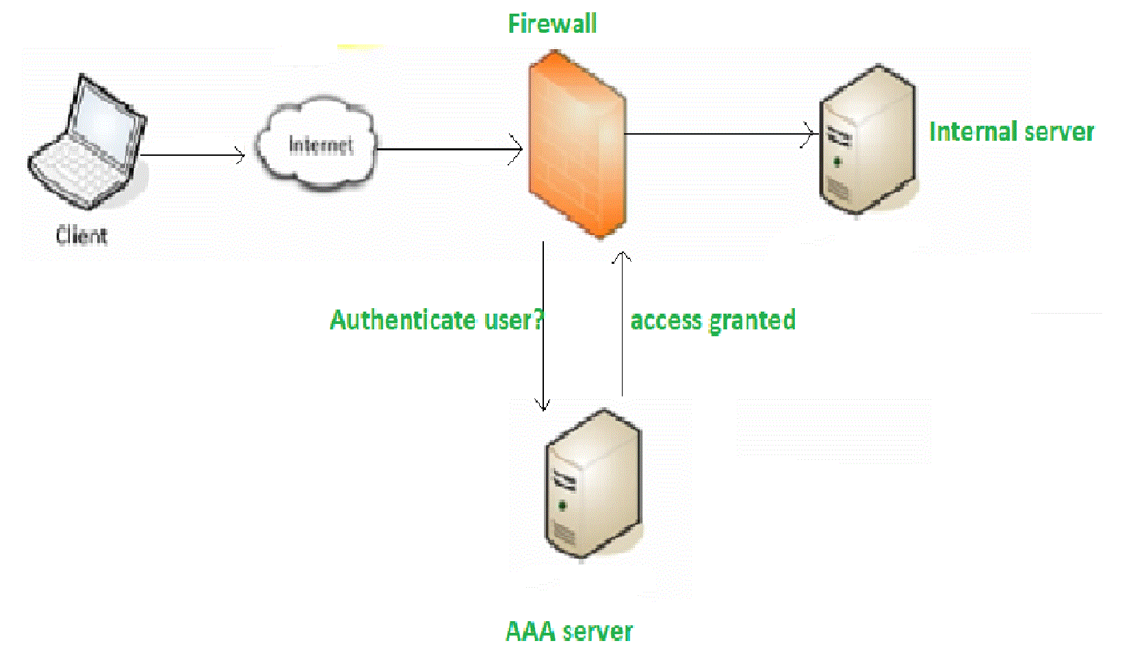
Authentication, Authorization & Accounting (AAA)

Slide 8
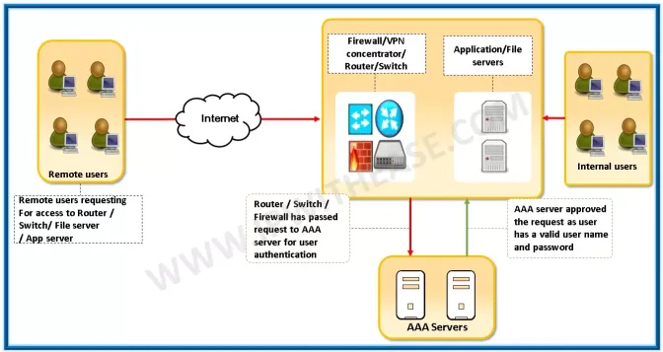
Authentication, Authorization & Accounting (AAA)

Slide 9
Authentication, Authorization & Accounting (AAA)
“The most commonly used protocols for a dial-in connection are the Point-to-Point Protocol (PPP) and the Serial Line Internet Protocol (SLIP). Both of these protocols require a minimum of a 1200 baud connection.
Although using Password Authentication Protocol (PAP) or Challenge Handshake Authentication Protocol (CHAP) for authentication is a viable option in smaller environments, the administrative overhead involved might become unmanageable in a larger environment. This is because each user should have a separate entry. A single entry can be made for multiple users. Imagine the overhead involved in setting up and maintaining 100 users, especially if you are trying to enforce a policy that requires changing of passwords every 60 days.”

Slide 10
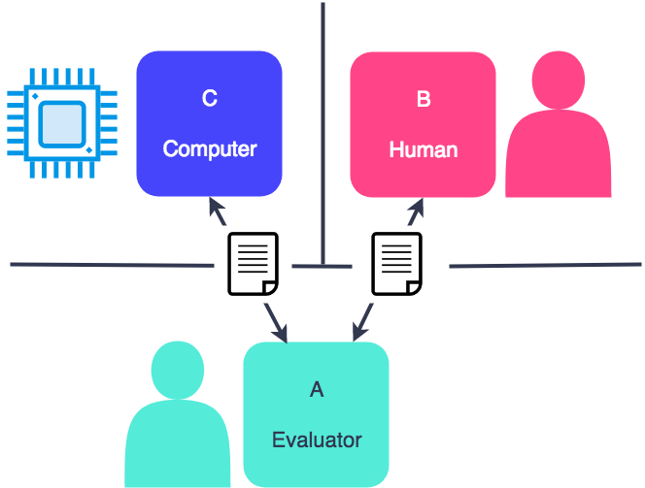
Authentication, Authorization & Accounting (AAA)
Convolutional Neural Networks (CNN) and reCaptcha

Slide 11
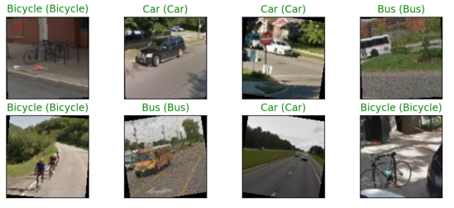
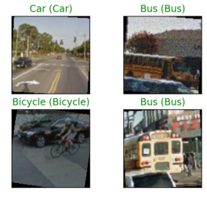
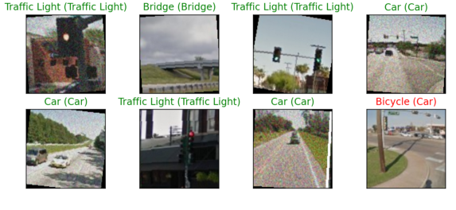
Authentication, Authorization & Accounting (AAA)
Convolutional Neural Networks (CNN) and reCaptcha
https://github.com/SIDD58/Captcha-recognition-using-CNN

Slide 12
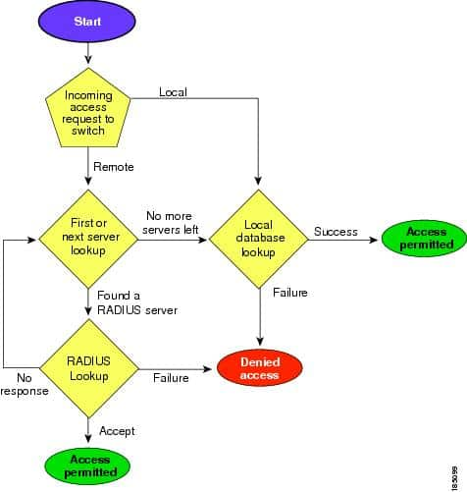
Cisco Nexus 5000 Series Switches

Slide 13
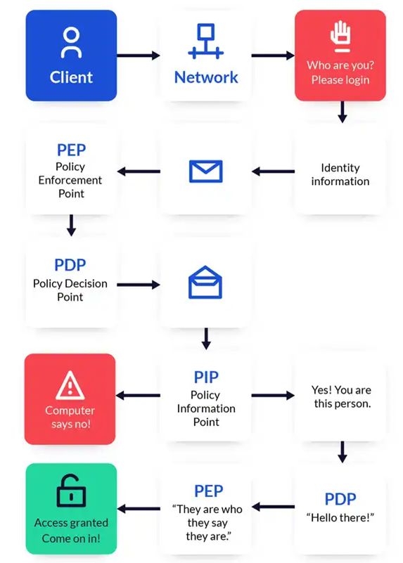
Security in Action

Slide 14
Defense in Depth
IT Security Strategy
Utilize multiple different layers of security measures to protect our network
Policies and Procedures
Physical Security
Perimeter Network
Internal Network
Camera, Locks, Fences, Guards
Firewalls and DMZs
Protected

Slide 15
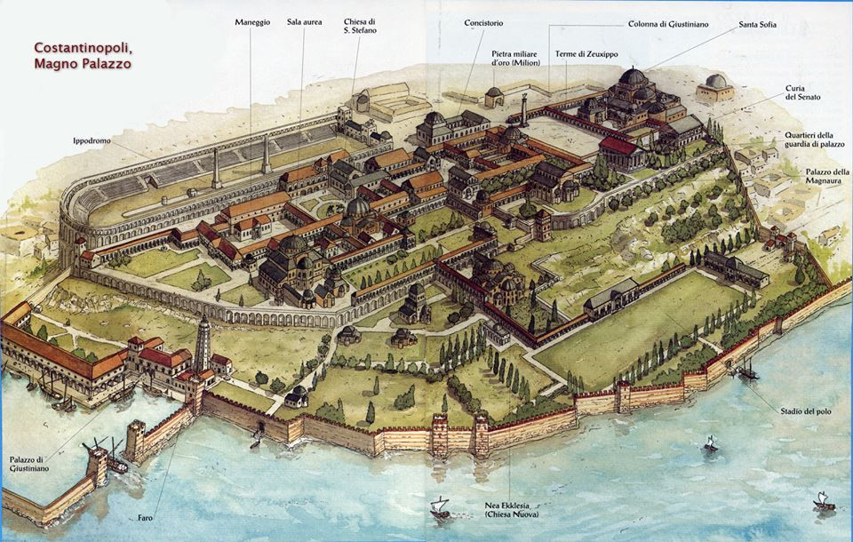
Defense in Depth
Inner walls
Watch towers
High walls
Moat
Security check

Slide 16
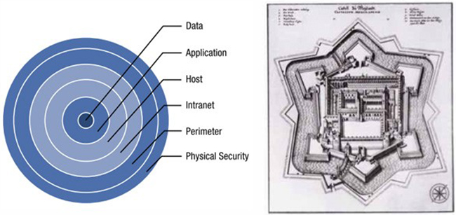
Defense in Depth

Slide 17
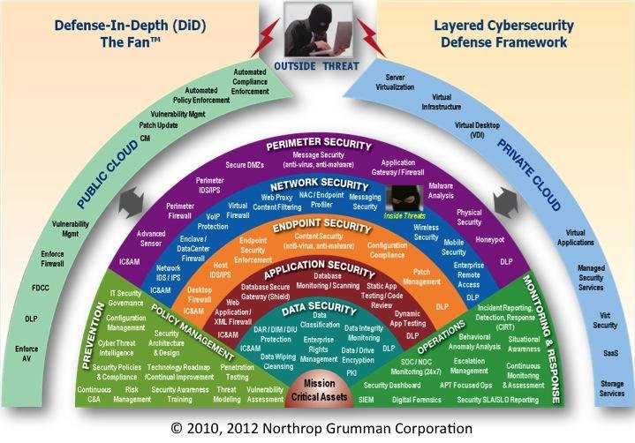
Defense in Depth

Slide 18
Defense in Depth
During a third-party vulnerability scan and security test, Danielle's employer recently discovered that the embedded systems that were installed to manage her company's new buildings have a severe remote access vulnerability. The manufacturer has gone out of business, and there is no patch or update for the devices. What should Danielle recommend that her employer do about the hundreds of devices that are vulnerable?
Identify a replacement device model and replace every device
Turn off all of the devices
Move the devices to a secured network segment
Reverse engineer the devices and build an in-house patch
Notes:
While answer C poses the least amount of costs, it would also be the easiest and quickest, it has faults. It violates defense in depth. Every layer of security should assume that other layers may fail.

Slide 19
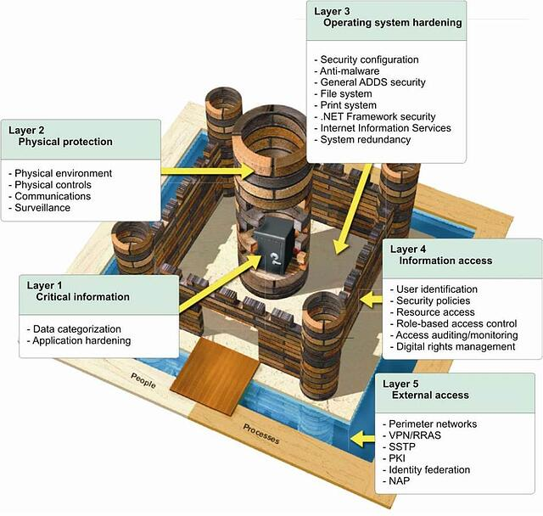
Is it secure?
Notes:
Insider Risk

Slide 20
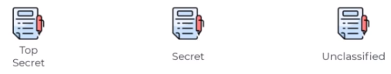
Least Privilege
Definition
A user, system, process, or application is only given the permissions necessary to complete its assigned tasks or functions and nothing more.
Implementing Least Privilege:
Security Groups
Account Standardization
Account Management Processes & Procedures

Slide 21
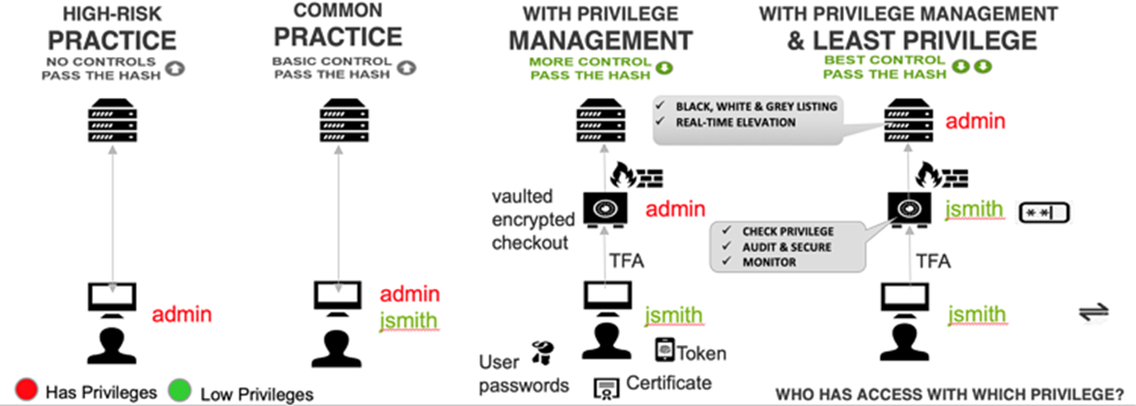
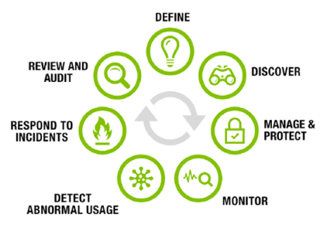
Least Privilege

Slide 22
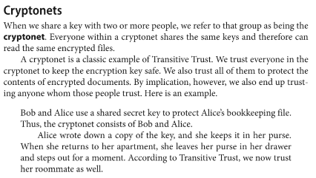
Three may keep a secret if one is dead (Benjamin Franklin)

Slide 23
Question
https://www.cbtnuggets.com/blog/technology/system-admin/linux-file-permissions-understanding-setuid-setgid-and-the-sticky-bit
Comment on setuid

Slide 24
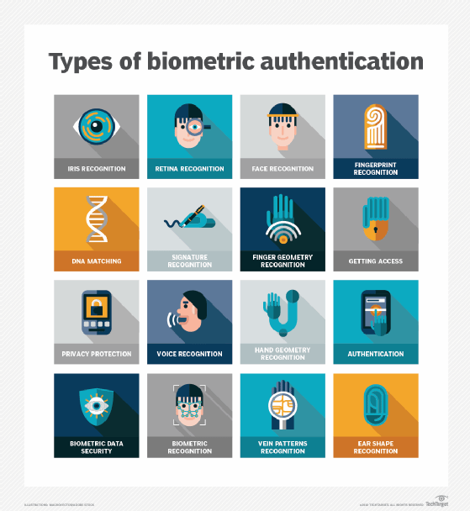
Non-Repudiation
Used to prevent an entity from denying an action took plAce
Examples: Digitally Signed Documents & Auditing System Logs

Slide 25
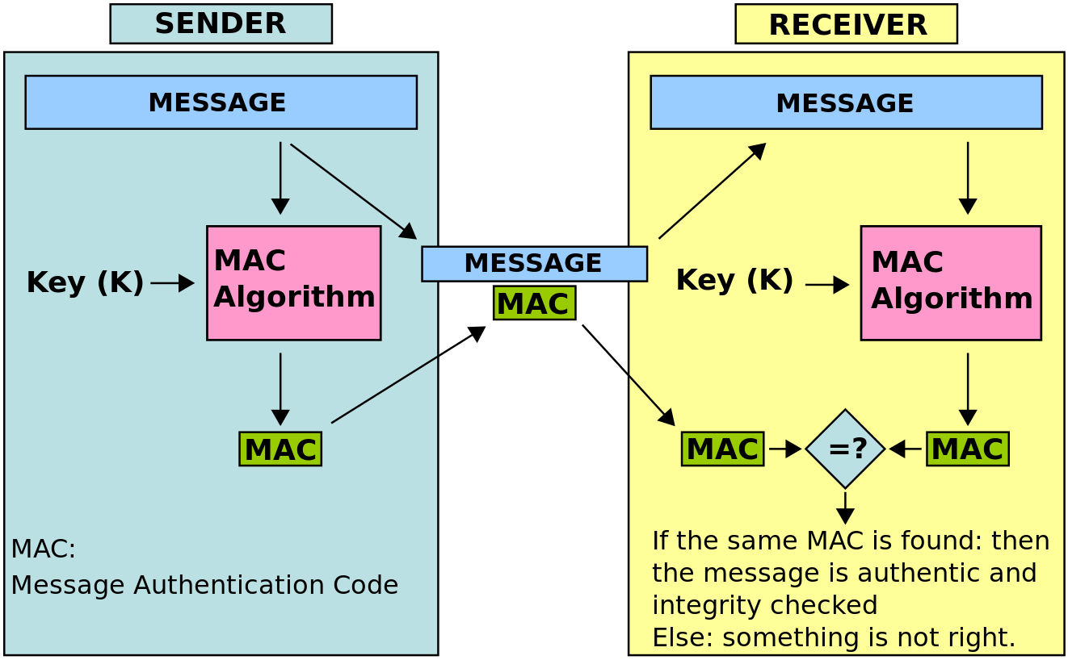
Non-Repudiation

Slide 26
Non-Repudiation
When is non-repudiation more important than confidentiality?
When signing an agreement that is legally binding, it is more more important that the signer cannot deny he signed the agreement than it is for no one to know the signer signed it.
A situation that violates non-repudiation
Keycard system that allowed cards to be shared.

Slide 27
Vernam Cipher Encrypt

Slide 28
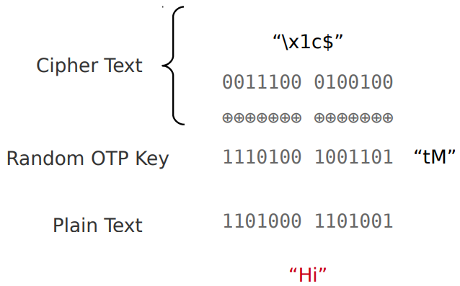
Vernam Cipher Decrypt

Slide 29
Question
Can cryptography provide nonrepudiation?

Slide 30
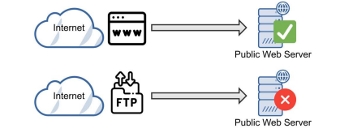
Implicit Deny
Indicates that unless something is explicitly allowed, it is denied
Implemented with Access Control Lists (ACLs)
Example
All internet traffic to a company’s web server is blocked, unless it is directed to a port 443 for HTTPs

Slide 31
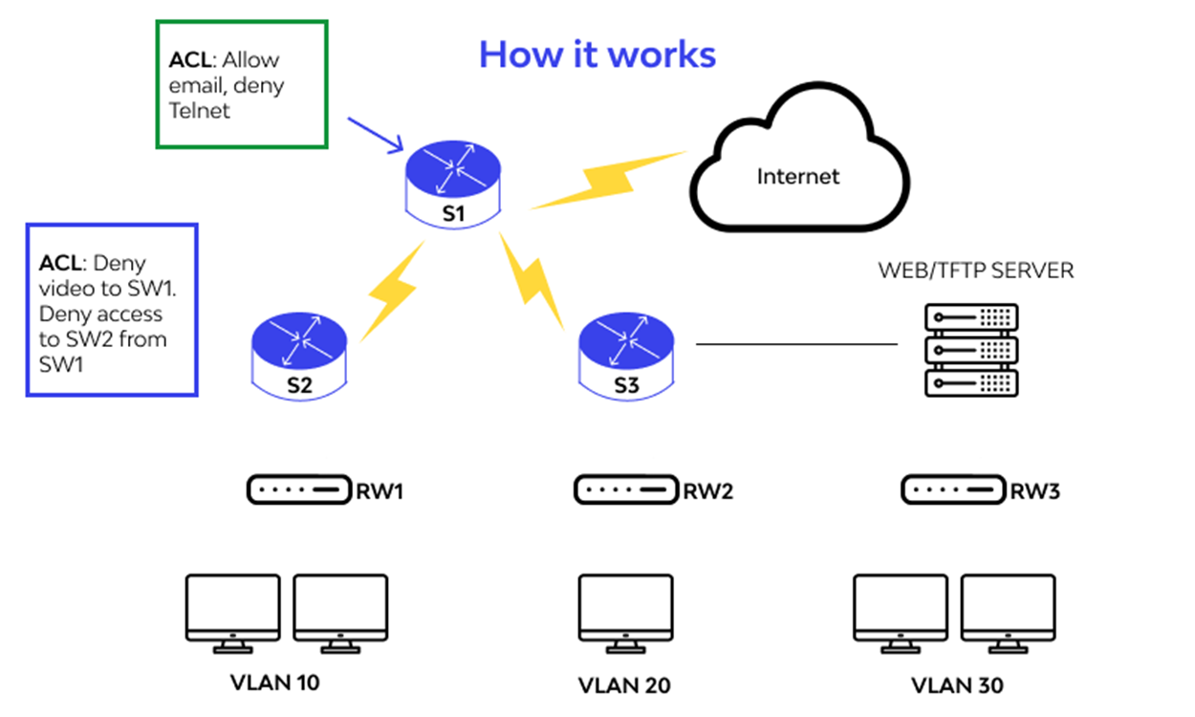
Implicit Deny

Slide 32
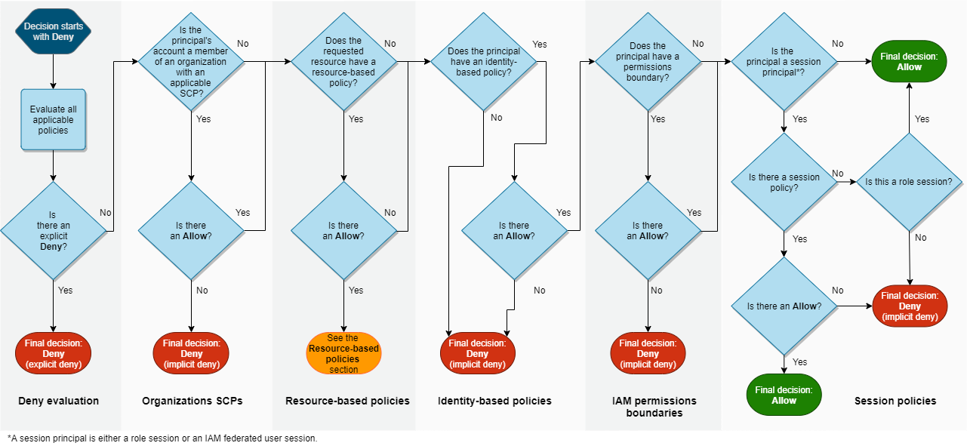
Implicit Deny

Slide 33
Difference between Implicit Deny and ACL?
The ACL is the entire list of rules.
The Implicit Deny is just one rule in the ACL that blocks all traffic that is not explicitly allowed.
If your firewall rules looked like this: Action\_\_\_\_\_\_Source\_\_\_\_Destination\_\_\_\_\_\_Port Allow\_\_\_\_\_\_\_192.168.0.0/16_\_\*\_\_\_\_\_\_\_\_\_80 Allow\_\_\_\_\_\_\_192.168.0.0/16\_\_\*\_\ \ \_\_\_\_\_\_443 Deny\_\_\_\_\_\_\_\_\*\_\_\_\_\_\_\_\_\*\_\_\_\_\_\_\_\_\*
The entire list would be called the ACL. Each individual rule is called an Access Control Entry or ACE. The last rule is the Implicit Deny.

Slide 34
Legal & Regulatory Issues and Compliance
Ignorance of a law is not a valid excuse
If you’re not in compliance, you could be held legally liable for your actions
Must be able to understand what laws and regulations within your industry that you must comply with.
USA
Information Security Management
FISMA
Health, Doctor, Dentist
HIPPA
Financial Organization
Gramm-Leach-Biley Act
Payment Card Industry – Standard
PCI-DSS

Slide 35
Due Care and Due Diligence
Due Care
Prudent man rule
Legal principle that restricts the investment choices of a person managing assets in behalf of another person or people
Doing what any responsible person would do
Implementing a security measure to mitigate against certain risks
Due Diligence
Essentially the management of due care
Ensuring the implemented security measure was done correctly
Gross Negligence
Opposite of due care
Not doing what a prudent man would do, you suffer negative loss
Could be held legally liable
Acted with gross negligence

Slide 36
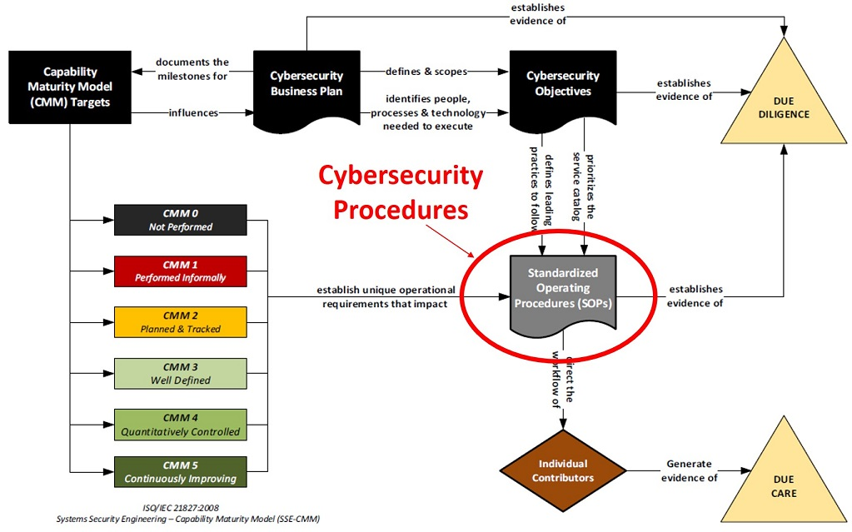
Due Care and Due Diligence

Slide 37
Information Security Governance
Information Security Governance is the process of how an organization manages its information security program via policies, procedures, roles, and responsibilities.
It provides strategic direction for security activities and ensures that cybersecurity objectives such as effective risk management are achieved.
Determines how much security is enough security.
Senior Management plays an essential role in information security governance because they:
Craft and mold the higher-level policies
Drive the direction of IT security based on business needs
Have the final say in all major decisions that impact the business
Effective IT security management needs to be a top-down driven approach, not bottom up.

Slide 38
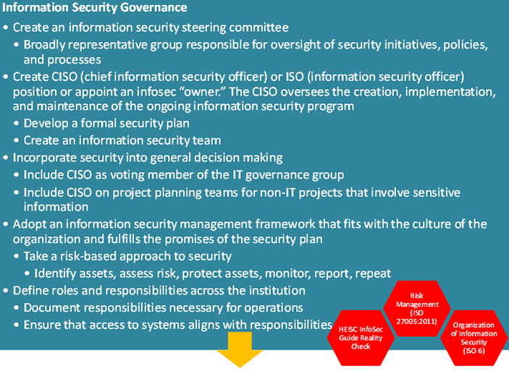
Roadmap to create a sustainable information security program.

Slide 39
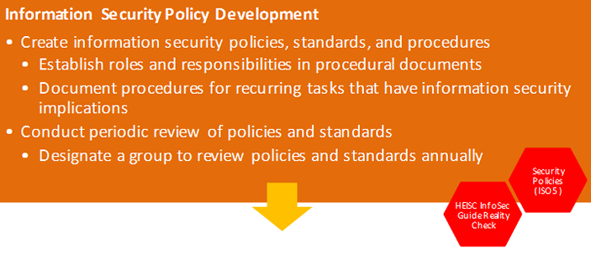

Slide 40
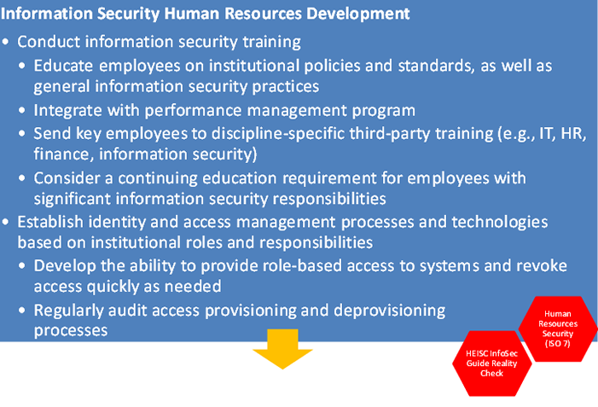

Slide 41
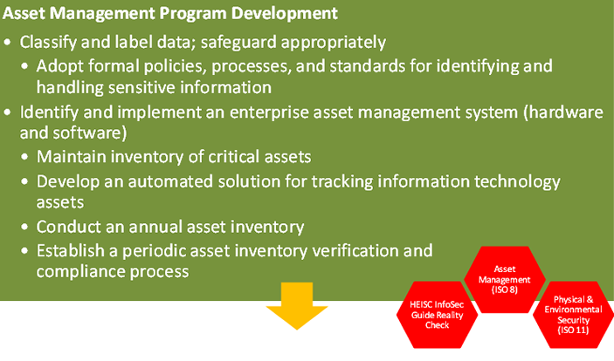

Slide 42
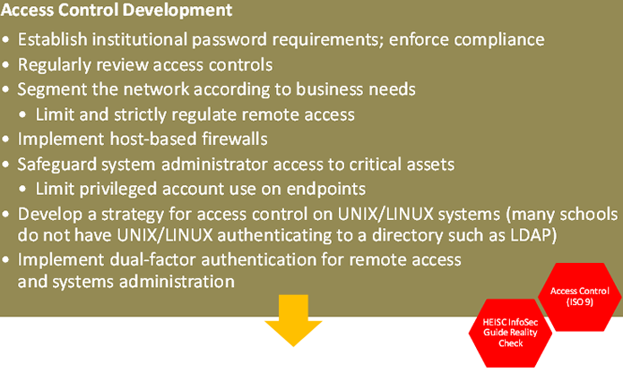

Slide 43
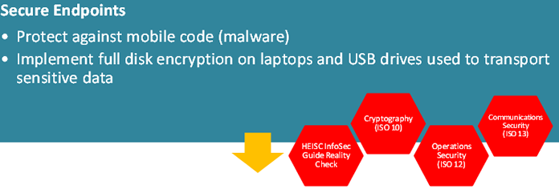

Slide 44
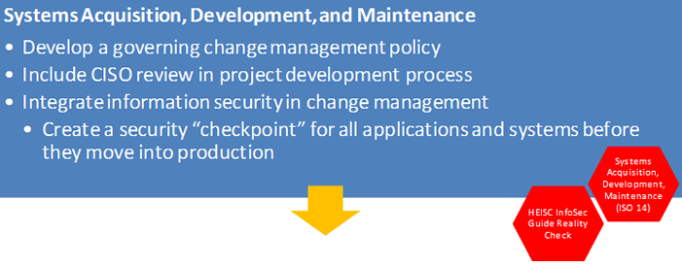

Slide 45
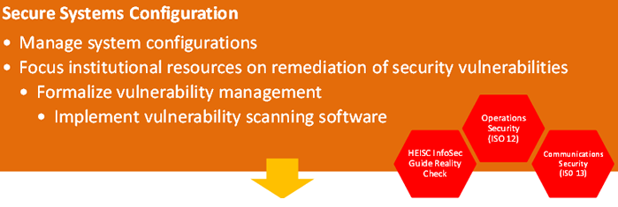

Slide 46
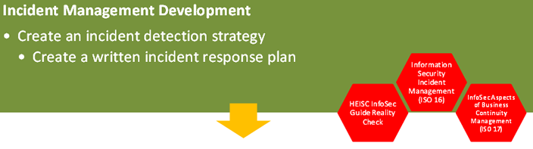

Slide 47
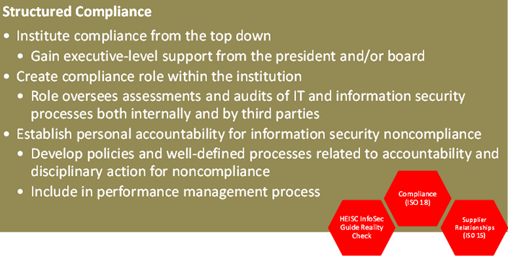

Slide 48
Authentication Basics
Authentication is used to prove identity by using some type of credential that is previously known by the authenticator.
Common Example: Username & Password
Can be used to prove the identity of:
A User
A Service or Process Running on a Computer or Server
A Workstation or Server Itself
A Network Device
In IT security, we need to authenticate more than just the people accessing the network and IT systems
We want to authenticate everything!
Core Aspect of IT Management
People, Processes & Technology

Slide 49
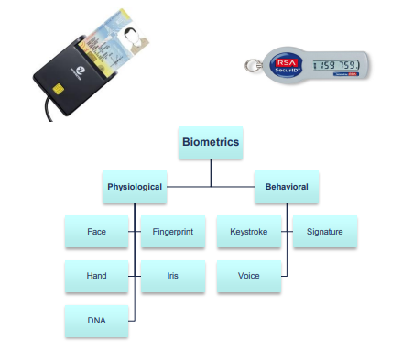
Three Factors of Authentication
Something You Know
Password
PIN
Something You Have
Smart Card
RSA Token
Something You Are
Biometrics

Slide 50
Two-Factor Authentication
Common Practice to Increase Security
Uses a combination of two of the three factors of authentication
Something You Have
Something You Know
Something You Are
Examples:
Banks: ATM Card & PIN
Gym Access: Biometrics Palm Scan & ID Card
Work ID Badges: SmartID Card & PIN Number

Slide 51
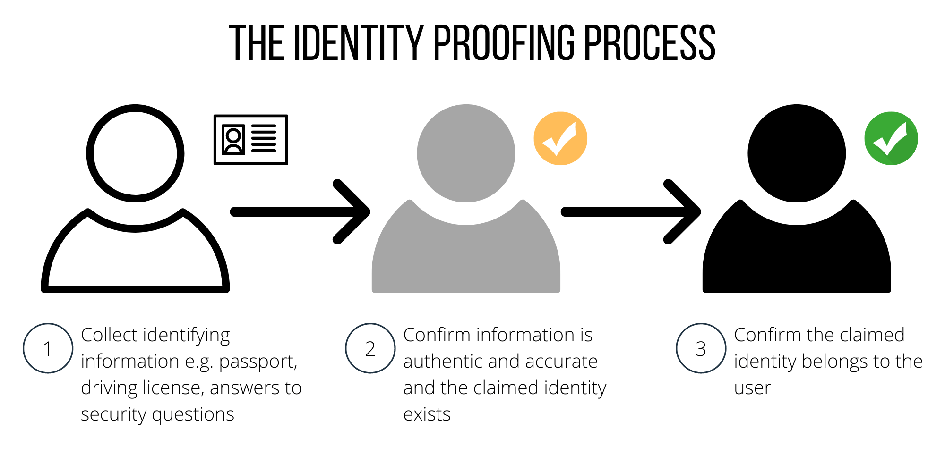
Identity Proofing
Not the same as authentication.
Before you give out credentials, you “Identity Proof” somebody.
Validates someone’s identity before credentials are issued
Driver’s License, Passport, etc

Slide 52
Example
Online Banking Login
You’ve forgotten your password and request a new password.
Your bank will identity proof your identity by one of the following methods:
Texting your registered cell phone number a temporary login PIN
E-mailing your registered e-mail account a temporary password
Asking you to answer security questions
You can’t log into your account unless your identity is proofed

Slide 53
General Password Rules
Passwords should be strong
8 Characters Minimum
Combination of Upper Case & Lower Case Letters, Numbers, and Special Characters
Passwords should not be written down
Passwords should not be shared
Passwords should be regularly changed
Every 60 to 90 days

Slide 54
General Password Rules
Passwords should not be reused
Don’t allow reuse of last 4 passwords
Account lockout policies should be used
Lockout user after 3 failed login attempts
Default passwords should be changed
New user default password expires after 1st use
https://www.passwordmonster.com/

Slide 55
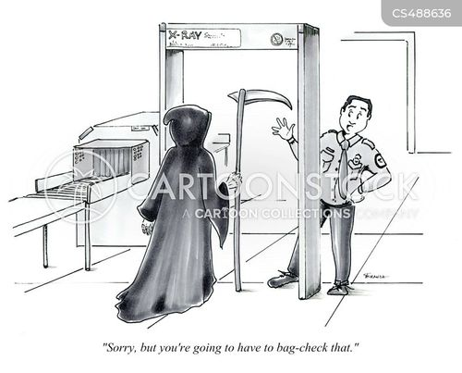
Security Check

